Slide 1
DSCI-549: Introduction to Computational Thinking and Data Science
1E – Data and accessibility of data

Slide 2
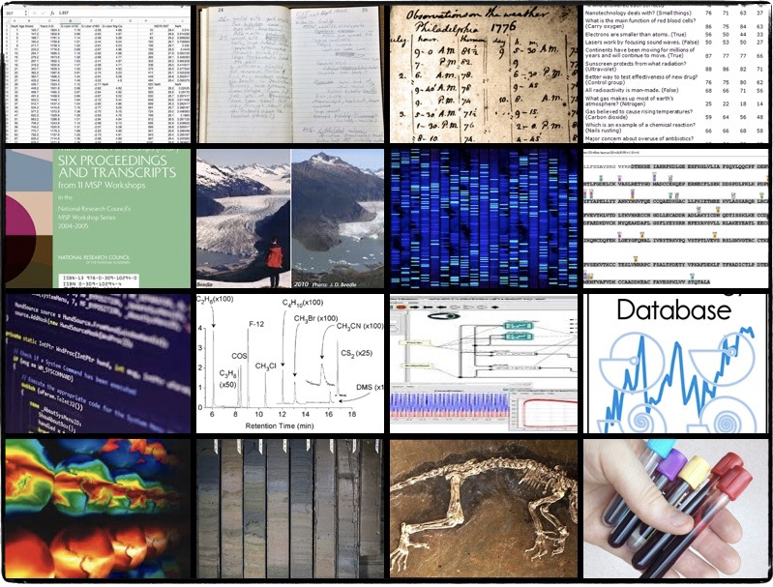
Data
Units of information collected for reference or analysis
Information processable by computer
Information in digital form
A program can read and analyze the information

Slide 3

Accessible Data
Right to access the data
Procedure to obtain or use the data
Option 1: locally
Option 2: Remotely

Slide 4
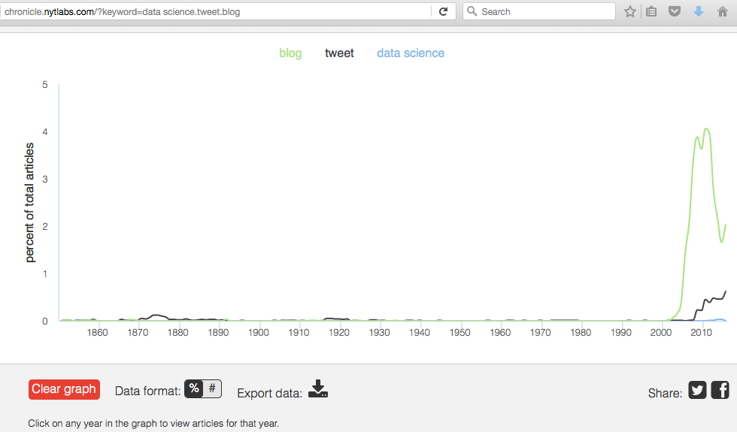
Manually accessible data
Accessible!

Slide 5
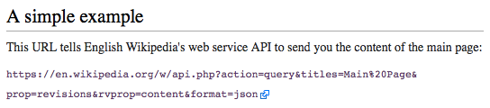
A program can access lots of data directly through an “API”
An API (Application Programming Interface) is a document that specifies what queries are possible and their format, and the format of the responses
Your application
Their data server
Give me
xyz data
Program
Data
API
Here is
that data

Slide 6
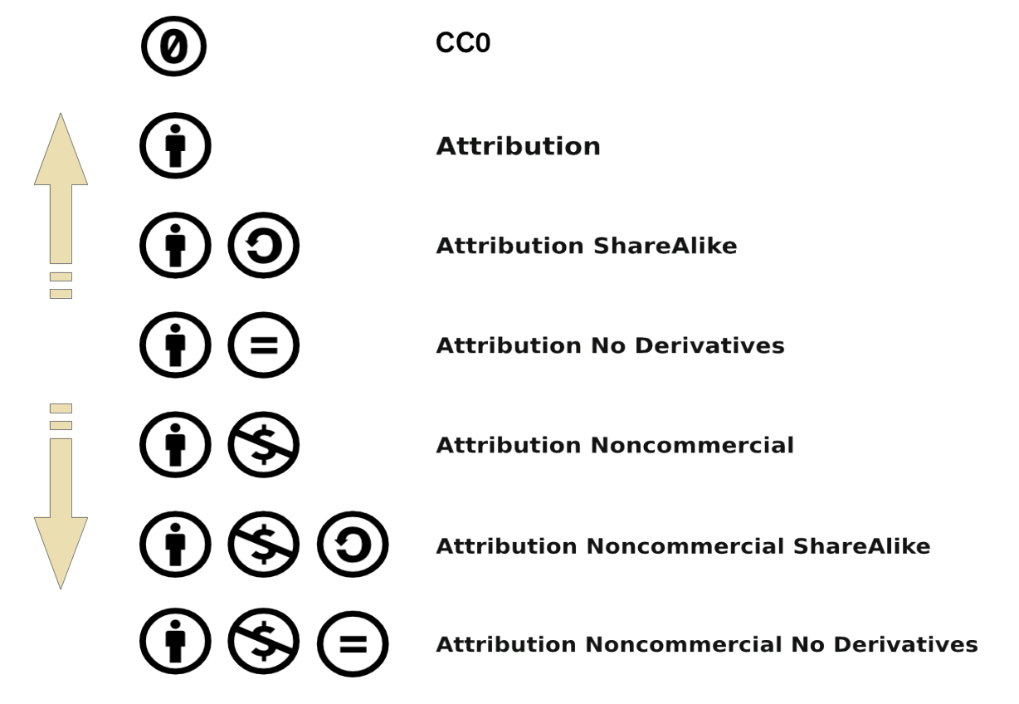

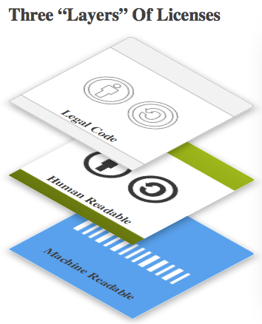
Licenses for data (https://creativecommons.org/licenses/)

Slide 7
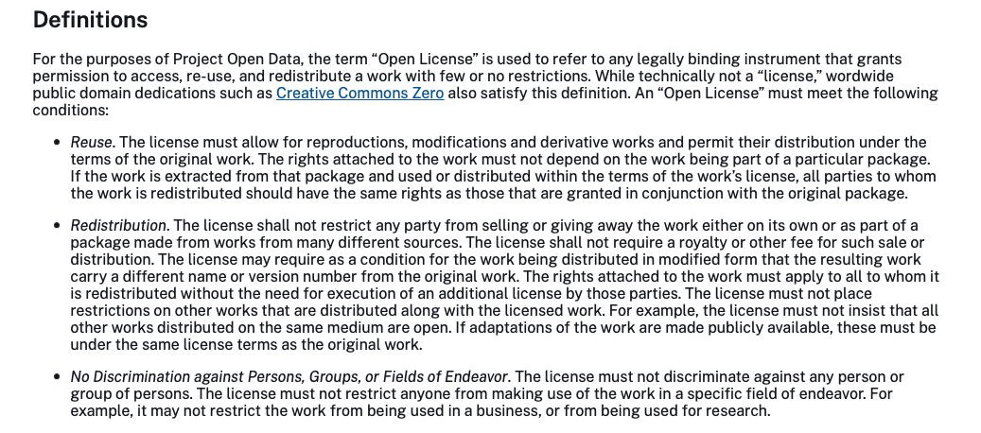
What is an open license?
https://resources.data.gov/open-licenses/

